Slide 1


SAP UI5 & FIORI with OData TRAINING
Anubhav Oberoy & Nishan Nainsukha
Day – 8

Slide 2

Agenda
Binding in SAP UI5
Expression Binding
Understand the use of Expression binding form an example
Binding Modes in SAP UI5
Introduction to Aggregation Binding
Creating a Table control
Creating a Dropdown List using the Aggregating Items
Formatter in SAPUI5

Slide 3
Binding in SAP UI5
Data binding is the process that establishes a connection between the application UI and business logic.
It is a bridge between a binding target and a binding source.
Property Binding
Expression Binding
Types of Binding in SAP UI5
Aggregation Binding
Element Binding
Property Binding:- When we bind property of a UI control, to the address of the model, this is called property binding. E.g. value property of Input control was connected to /emp/empId

Slide 4

Expression Binding
Expression binding : - When we bind an Expression ({= condition ? true : false}) with the property of a control rather binding value to a property, this is called expression binding.
If we need some calculation on model data or some sort of comparison, then expression binding is useful.
Syntax:
numberState = “{= ${path} > value ? ‘conditionForTrue’ : ‘ConditionForFalse’ }”
This saves the overhead of defining a function and is recommended in cases where the formatter function has a trivial implementation like comparison of values. Expression binding is especially useful in the context of SAPUI5 XML templating where XML views with templating are preprocessed so that the SAPUI5 controller is a natural place to put custom formatter functions that are not available.
Note: - To use expression binding, you need to enable extended binding syntax via the configuration setting in index.html file
data-sap-ui-bindingSyntax="complex"

Slide 5
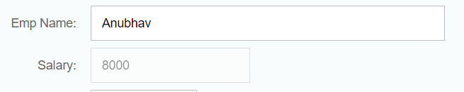
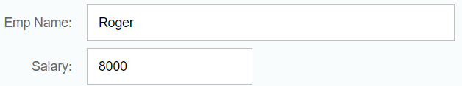
Use case of Expression Binding
My Manager want to add a button and when we click on that button, all the fields should gray out.
If The Employee Name is Anubhav, Gray out Salary field.
Condition – if employee name = Anubhav
Outcome – make field gray out
Target – Salary field
If Employee name = Anubhav
If Employee name != Anubhav

Slide 6

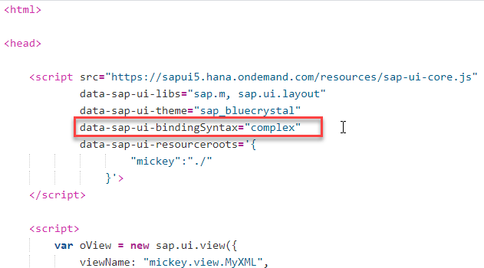
Exercise 1
In this exercise we will see the example of both property binding and expression binding.
In this file we also see that how to get data form the file in the model.
Exercise code:-
MyXML.controller.js
MyXML.view.xml
Index.html

Slide 7
Aggregation Binding
When we bind the aggregation of a control with the entityset of data model, it is called aggregation Binding.
The parent control (e.g. Table) is bound to the EntitySet path which is called absolute path and the child of the parent Control (e.g. Columns) are connected to the child properties of the EntitySet is called relative path.
In aggregation binding, based on your model data, as many child controls will be created automatically.
Every Event of UI5 will trigger the eventHandler and we will get the Event Object as part of the event Handler. Depending on the event, the event handler object will have different parameters.
Use Case of Aggregation Binding
If we want to show a list or some data in tabular format, we need to bind a group of data. In such a case we will use aggregation binding.
Absolute path
{
“empTab”: [
{
“empId”: 50,
“empName”: “Jay”,
“salary”: 9500
}
]
}
Table = {/empTab}
Emp Id | Emp Name | Salary
{empId} | {empName} | {salary}
Relative Paths

Slide 8

Exercise 2
In this exercise we will bind the sample data with a table control.
To bind the table we will use aggregation bind.
In this we will also create a dropdown inside a cell in the table.
Exercise code:-
MyXML.view.xml
MyXML.controller.js
data.json
sample.json

Slide 9
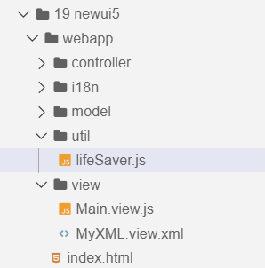
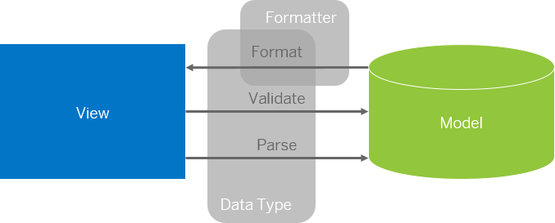
Formatter in SAP UI5
Formatters are used to define the formatting of data on the UI while data types work in both directions: they format the data on the UI and parse and validate user input that is entered.
Formatter is a function, This function gets called JUST Before the binding takes place with the view.
Formatter file is placed in a folder in webapp folder and the file can be named anything with the .js extension.
Formatter

Slide 10

Exercise 3
In this exercise we are going to currency code in the table.
We will convert the currency code into it corresponding currency symbol.
We will achieve this by using a formatter function.
Exercise Code:-
MyXML.view.xml
MyXML.controller.js
lifeSaver.js

Slide 11

End of Day 8

Slide 12

Any Questions ?

Slide 13

Anubhav Oberoy

Slide 14
Title
Content

